Slide 1
BACK END PROYECTO
SNAKE API GAME

Slide 2
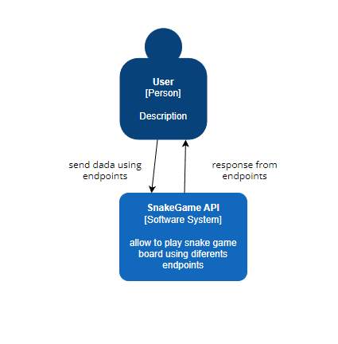
System Context diagram

Slide 3
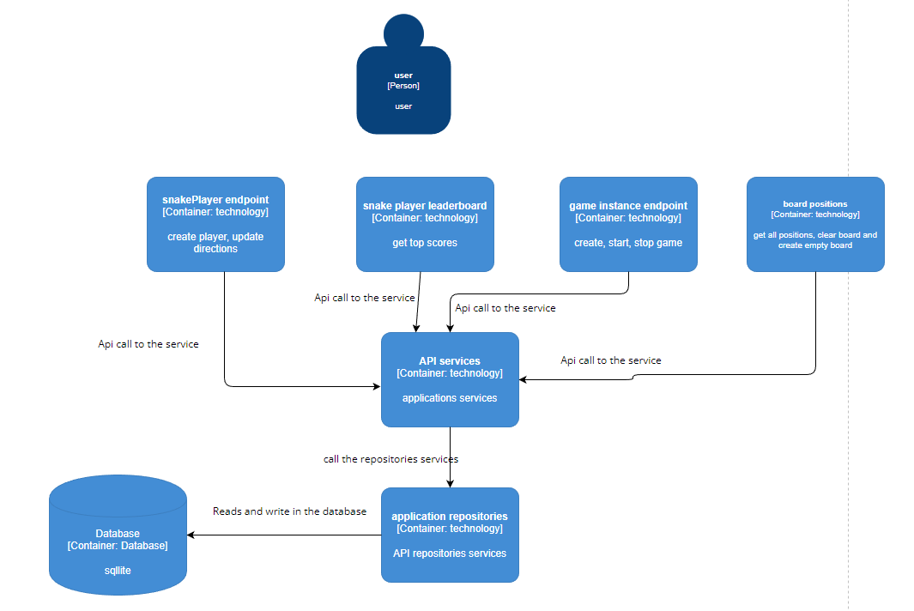
C4 MODEL CONTAINERS

Slide 4
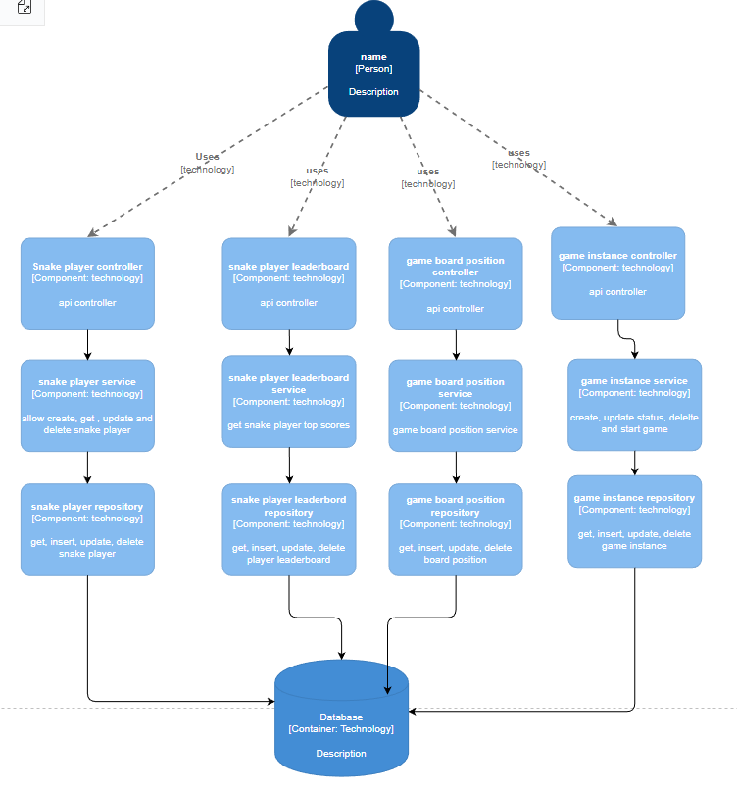

Slide 5
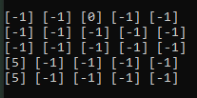
Board Game
[-1] = casilla vacía
[0] = comida
[5] = jugador

Slide 6
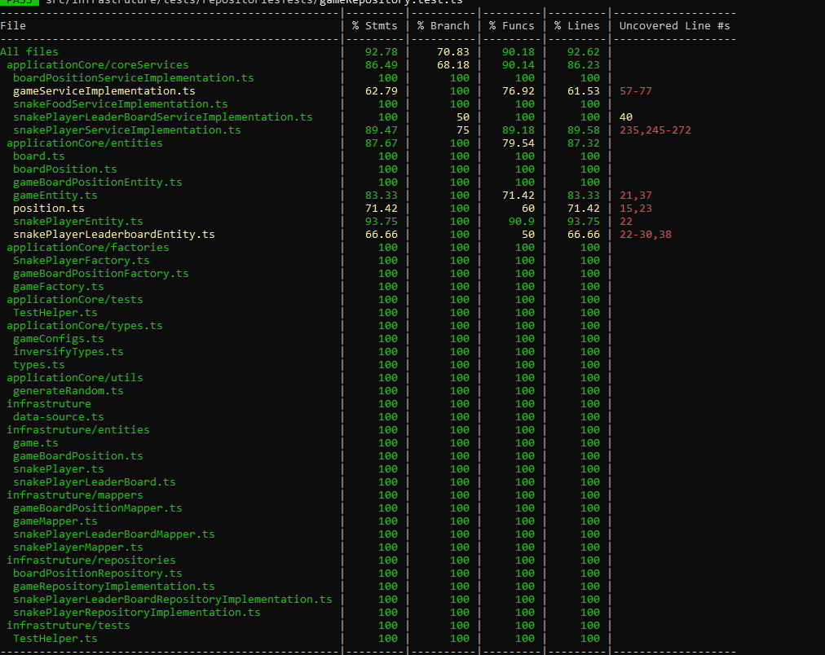
Tests

